Slide 1


COMFORTMAP
The trust layer for elderly care
Live transparency between care homes and the families who love them.
SEED INVESTMENT DECK · 2026
comfortmap.ro

Slide 2


01
THE PROBLEM
A BLIND,
HIGH-STAKES
DECISION
Families hand over the people they love most — with no window into daily care.
4.6M
Staff lose hours every week to repetitive calls from anxious relatives.
Romanians live abroad — families who cannot simply visit.
No transparency means no trust — and good homes silently lose occupancy.
COMFORTMAP
02

Slide 3

WHY THIS, WHY NOW
THE TIMING IS NOW
Aging demand
A diaspora that pays
Regulation rewards proof
A digital gap
Residential elderly-care demand is rising fast across Europe.
Millions abroad will pay for daily peace of mind.
Inspections (DSP / ANPIS) favour documented, transparent homes.
The sector still runs on phone calls and WhatsApp.
COMFORTMAP
03

Slide 4

02
THE SOLUTION
TRANSPARENCY,
AUTOMATED
Staff log a 2-minute daily journal. Families see updates, photos and a weekly report — instantly. Peace of mind stops depending on a phone call.
2 min
Real-time
Certified
daily staff effort
family visibility
ComfortMap trust badge
COMFORTMAP
04

Slide 5




03
THE PRODUCT
WHAT THE APP DOES
Daily journal
Daily photos
Direct messaging
Weekly report
Staff document care in 2 minutes — meals, mood, activity, sleep.
One photo a day is worth more than ten phone calls.
Private, GDPR-safe chat between the home and the family.
An automated wellbeing summary every Monday at 7:00.
COMFORTMAP
05

Slide 6

04
TWO-SIDED NETWORK
EARN THE BADGE.
WIN THE FAMILY.
Public ComfortMap profile
Every member home gets a public page — discoverable when families search.
ComfortMap Certified badge
A visible trust mark, on the door and online, that competitors must earn.
Directory placements
Families discover, compare and choose — homes fill beds through the platform.
COMFORTMAP
06

Slide 7
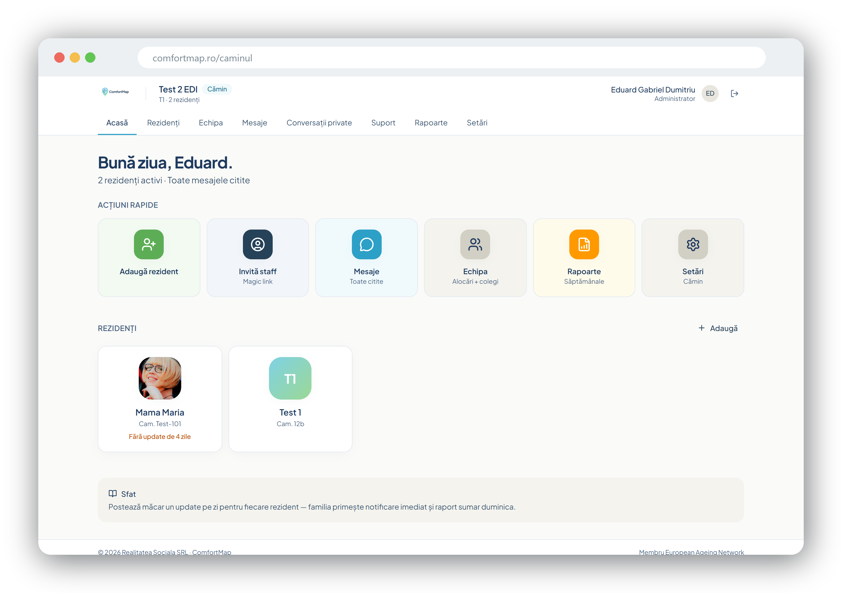
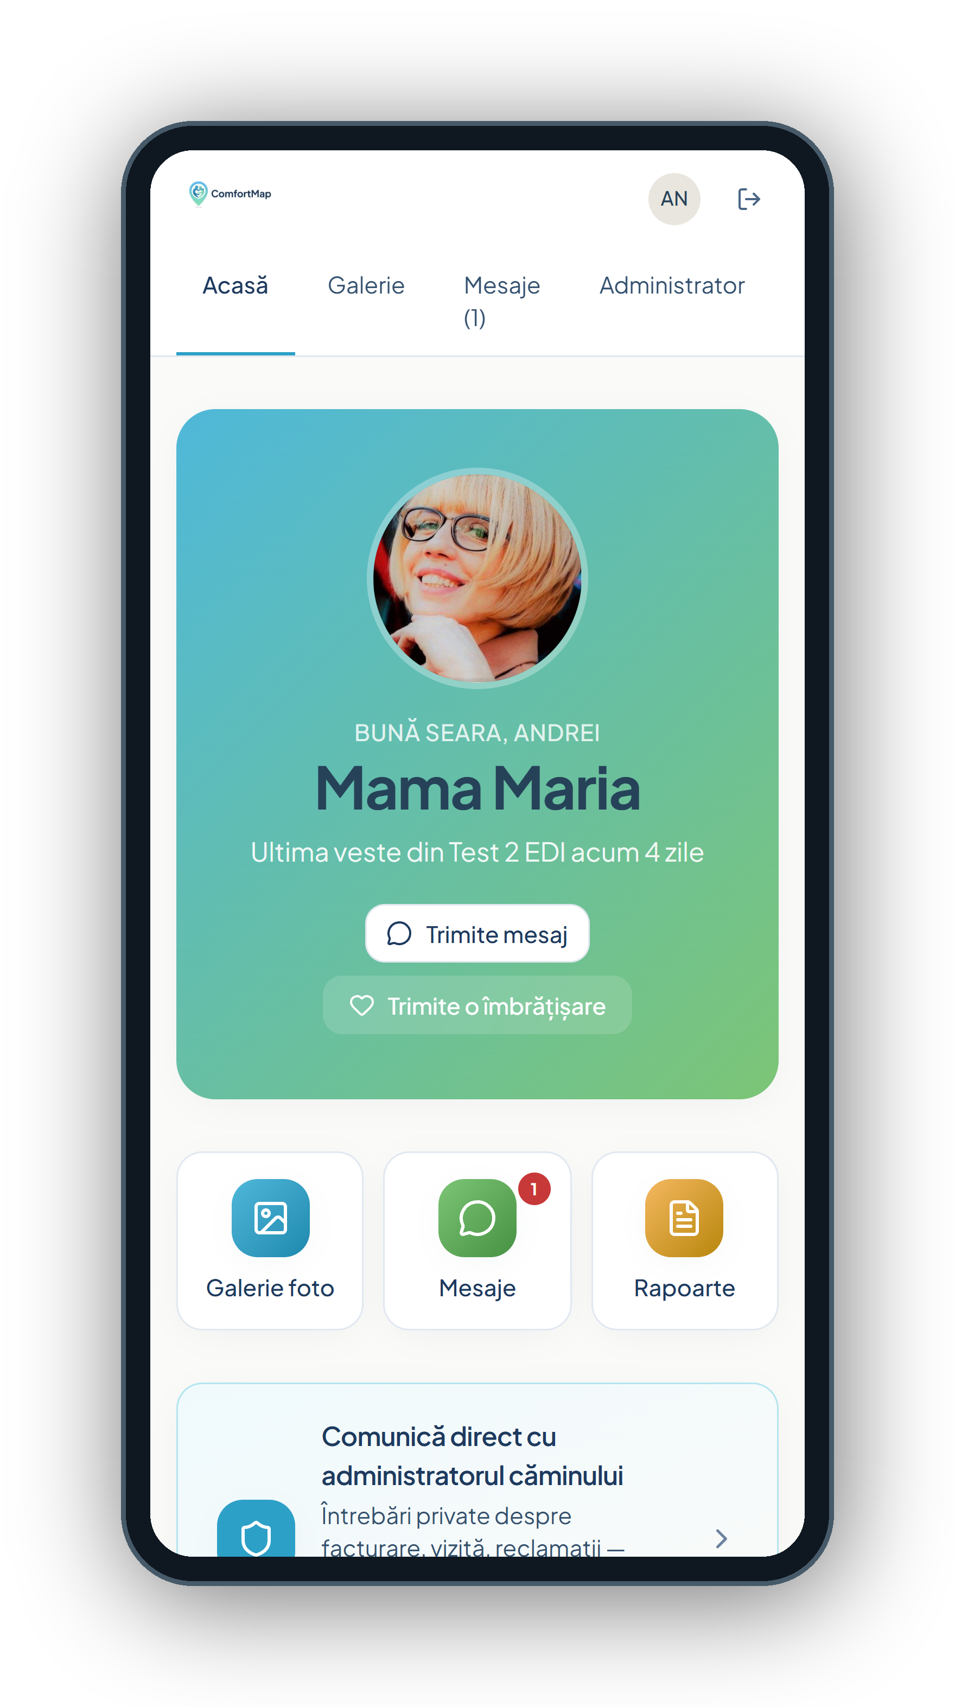
DE-RISKED EXECUTION
ALREADY BUILT.
ALREADY LIVE.
Everything here is the real product — in production today at comfortmap.ro.
In production
Families and homes using it live, every day.
Security-hardened
Independently audited · GDPR-remediated.
EU-hosted
Staff dashboard + family app — the real ComfortMap.
Data in Frankfurt · reports generated server-side.
COMFORTMAP
07

Slide 8
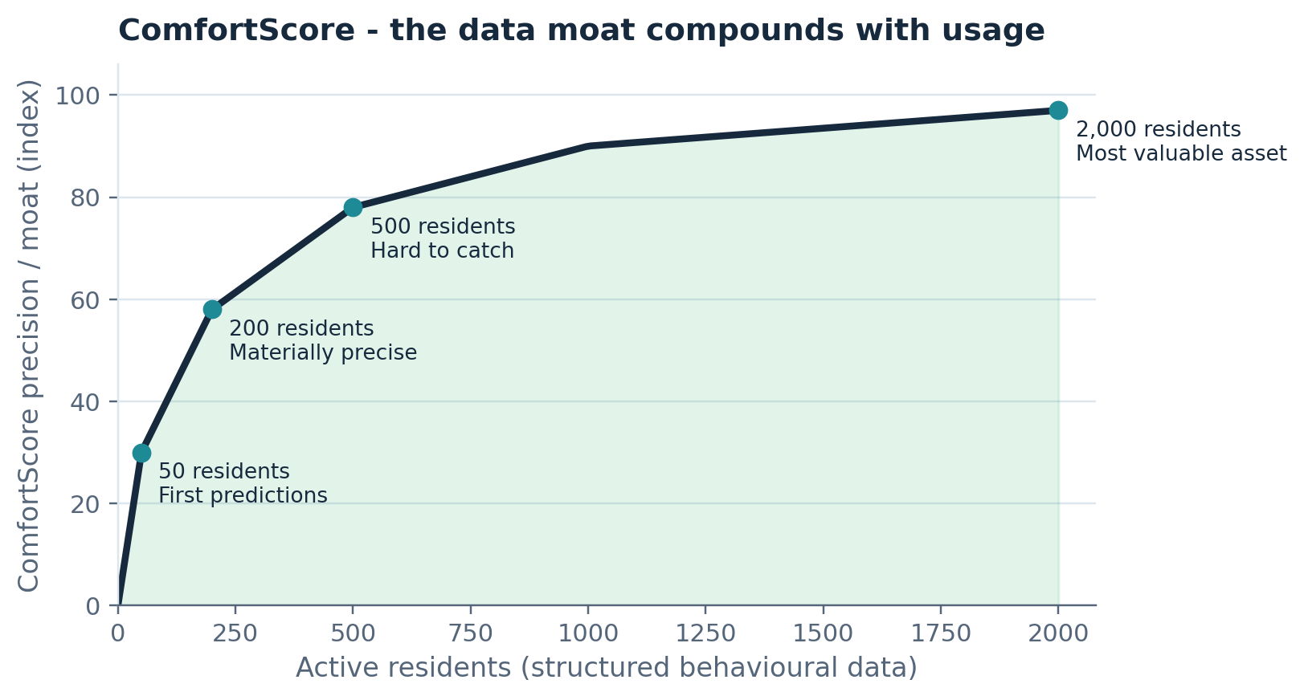
05
DEFENSIBILITY
COMFORTSCORE —
THE DATA MOAT
A proprietary AI score of comfort and care quality, built from structured daily behavioural data.
The more homes and residents use ComfortMap, the more precise the score — and the harder it is to replicate.
COMFORTMAP
08

Slide 9

WHERE THIS GOES
THE DIGITAL TWIN
A predictive wellbeing model of each resident's daily life.
Predict, don't react
From app to infrastructure
Durable enterprise value
Early signals for health and quality-of-care, surfaced before they become incidents.
ComfortMap becomes the data layer the entire sector runs on.
The asset that underwrites a premium, defensible valuation.
COMFORTMAP
09

Slide 10
THE OPPORTUNITY
A MASSIVE, GROWING MARKET
€1.05T
5.8%
€325B
600–800
Global elderly-care services market, 2025
Annual growth (CAGR) toward €1.74T by 2034
European serviceable market
Private care homes in Romania today — thousands across CEE
Land in Romania → expand across CEE → Europe. One transparent home at a time.
COMFORTMAP
10

Slide 11
06
HOW WE MAKE MONEY
THREE REVENUE STREAMS
01
02
03
RECURRING
MARKETPLACE
FUTURE
Membership SaaS
ComfortMap Directory
Data & insights
Managed service per home, billed monthly by resident tier.
Booking-style placement fees plus premium listings.
ComfortScore benchmarking and sector intelligence.
€150 / €250 / €350 / €450 per month + €250 setup
~€300 per placement · ~9 placements / home / year
High-margin, future upside on a unique dataset
COMFORTMAP
11

Slide 12
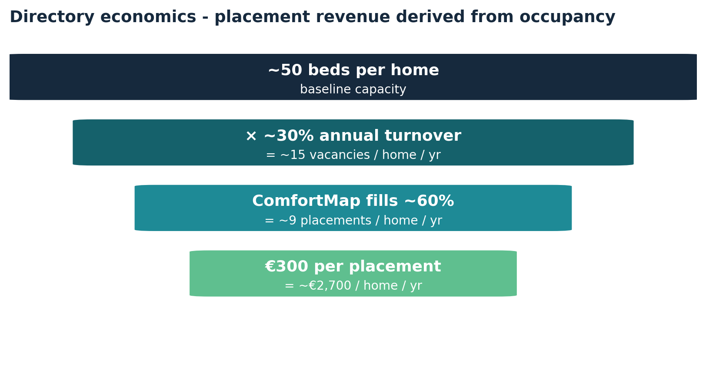
DIRECTORY ECONOMICS
REVENUE FROM OCCUPANCY,
NOT GUESSWORK
You can only be listed if you are a paying member — listed homes = members.
Placements are modelled on real bed turnover, not optimistic assumptions.
A marketplace layer that compounds on top of recurring SaaS.
COMFORTMAP
12

Slide 13
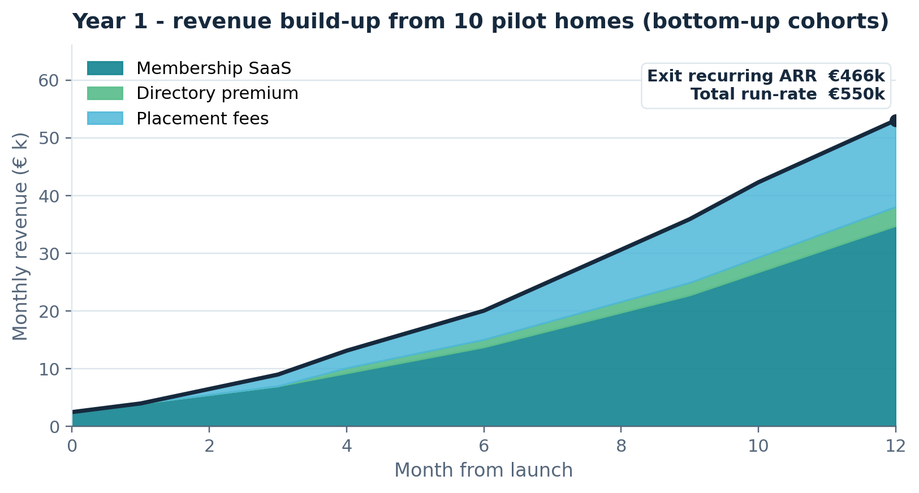
BUILT BOTTOM-UP
FROM 10 HOMES TO
€466K ARR — YEAR 1
We start from ~10 pilot homes and grow month by month with a conservative 10% annual churn.
We separate exit ARR (run-rate) from recognised revenue (cash on the ramp) — investor-honest.
COMFORTMAP
13

Slide 14
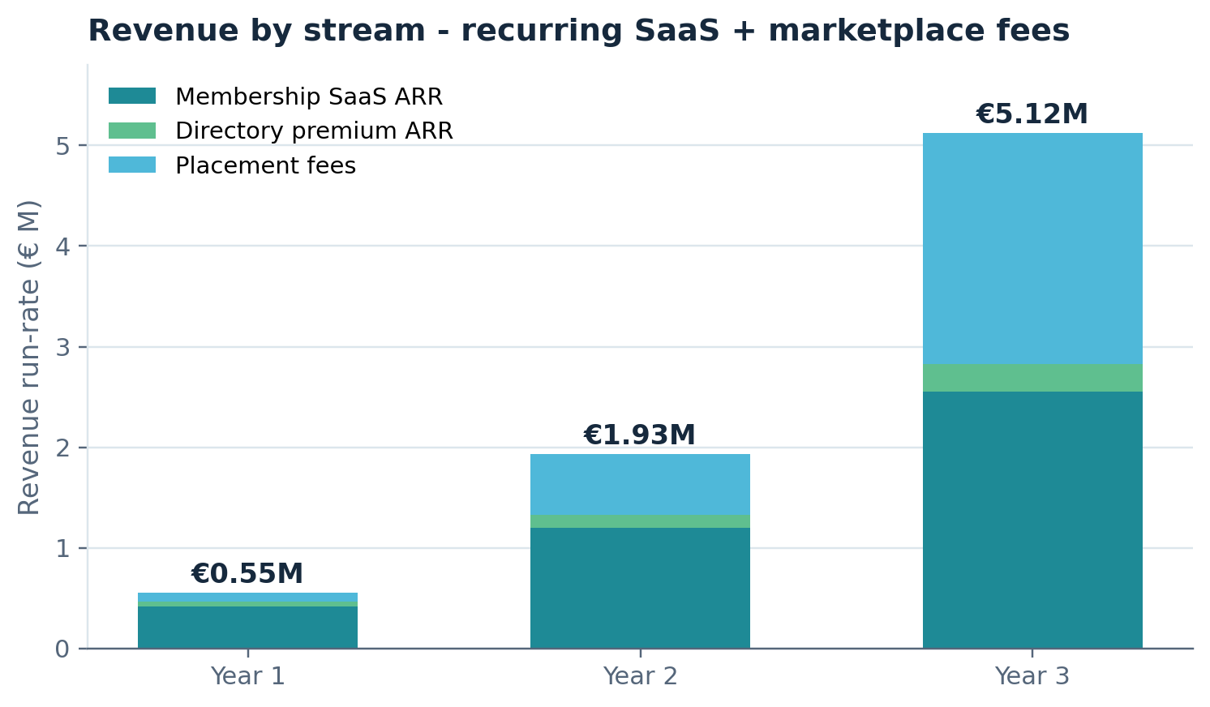
THE NUMBERS
THREE-YEAR PROJECTION
€550K
Year 1 total run-rate
€1.93M
Year 2 total run-rate
€5.13M
Year 3 total run-rate
Member homes (= listed): 140 → 400 → 850
COMFORTMAP
14

Slide 15
EFFICIENCY
UNIT ECONOMICS THAT COMPOUND
85%
€1,200
8.7×
Gross margin
Blended CAC
LTV : CAC
5.6 mo
>150%
10%
CAC payback
Net revenue retention
Conservative churn / yr
COMFORTMAP
15

Slide 16
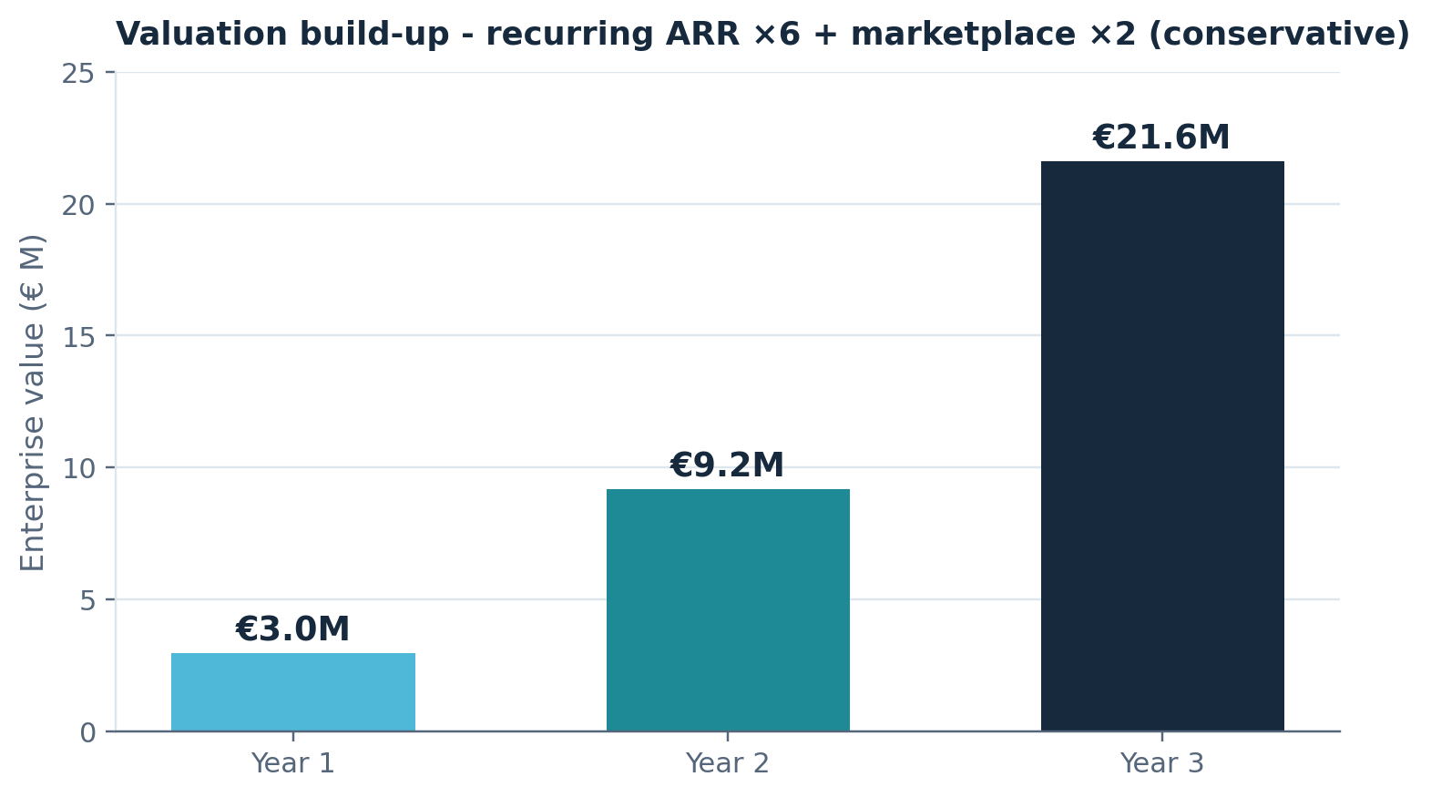
VALUATION
VALUATION BUILD-UP
€21.6M
Year-3 enterprise value
Blended and conservative: recurring ARR valued at 6× plus marketplace revenue at 2× — below the ~6× SaaS median.
€2.96M → €9.18M → €21.6M across Years 1–3
COMFORTMAP
16

Slide 17

THE ASK
WE'RE RAISING
€200K
to scale the proven product across Romania and CEE.
18 months
of runway to Year-2 metrics
Use of funds
Sales & distribution · CEE expansion · ComfortScore engine
Milestones
400 homes · €1.33M ARR · first CEE market
COMFORTMAP
17

Slide 18
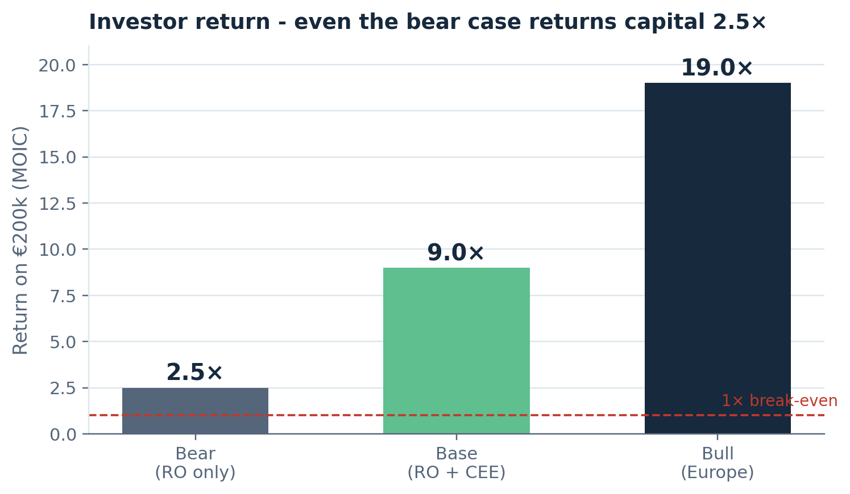
WHAT YOU MAKE
INVESTOR RETURNS
2.5×
Bear — Romania only. Even the downside returns capital.
9×
Base — Romania + CEE. ~75% IRR over ~4 years.
19×
Bull — European expansion.
COMFORTMAP
18

Slide 19

LET'S BUILD THE STANDARD
FOR TRUST IN ELDERLY CARE
Romania today · CEE next · Europe in sight
comfortmap.ro · hello@comfortmap.ro · București, România

